Slide 1
Summarization
USC VSoE CSCI 544: Applied Natural Language Processing
Jonathan May -- 梅約納
Nanyun (Violet) Peng -- 彭楠赟
November 9, 2018
Slides from Lu Wang and Abi See

Slide 3
Why Summaries?
Speed up decision making
Is this document important enough for me to keep reading?
(Cross lingual) Should I pay to have it translated?
Query-focused summaries enable users to find more relevant documents more accurately, with less need to consult full text of the document [Mani et al. 2002]
Current research project: given an English query, find relevant documents in a foreign language, then produce English summaries.
Usage: should we bother translating this document?

Slide 5
Possible Outputs
Keywords (e.g. word cloud)
Highlighted information from the input
Bigger chunks from the input
General interpretation of the input (not necessarily a chunk)

Slide 6
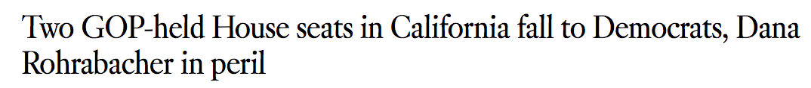
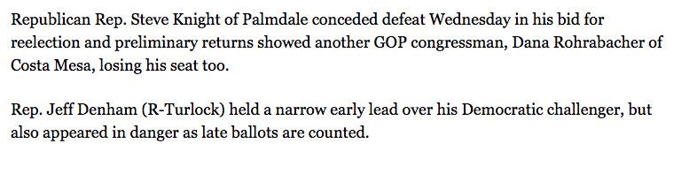
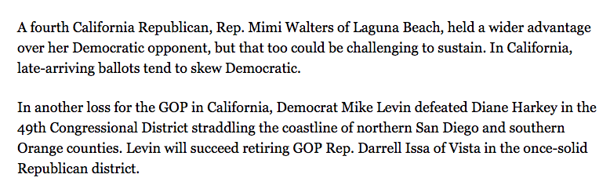
Input: LA Times Article
... (1400 words)
http://www.latimes.com/politics/la-me-pol-california-election-house-20181106-story.html

Slide 7
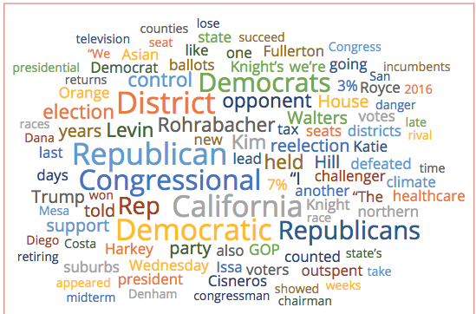
General Summary Word Cloud
displayr.com

Slide 8
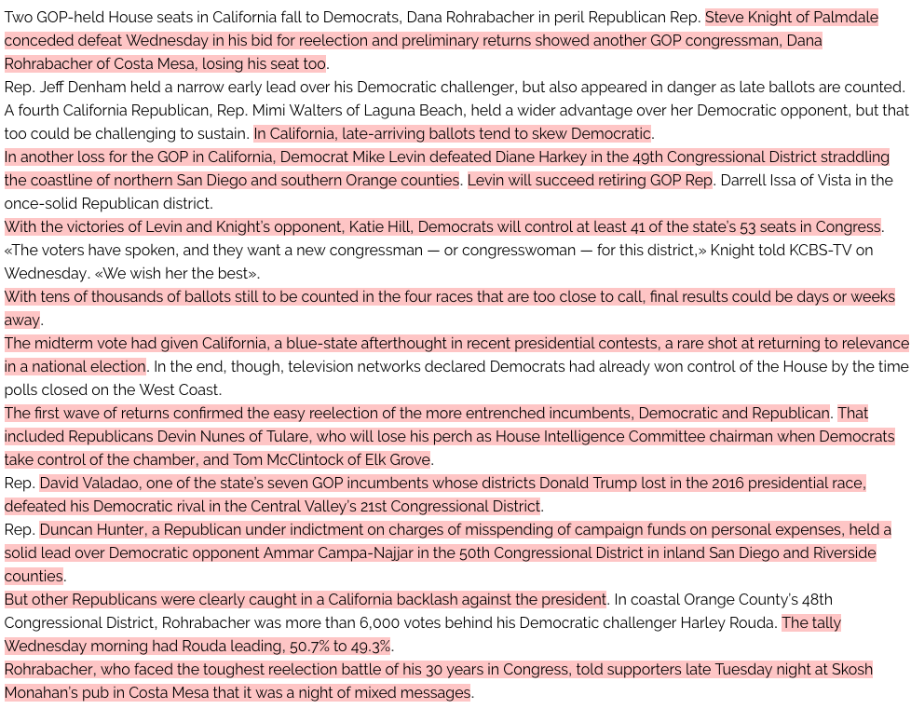
Important Chunks Highlighted
resoomer.com

Slide 9
What To Summarize
Single Document
Abstract
Outline
Headline
Multiple Document Corpus
Series of news stories
Collected views on an issue
Analysis of a variety of disparate sources – automatic journalist!

Slide 10
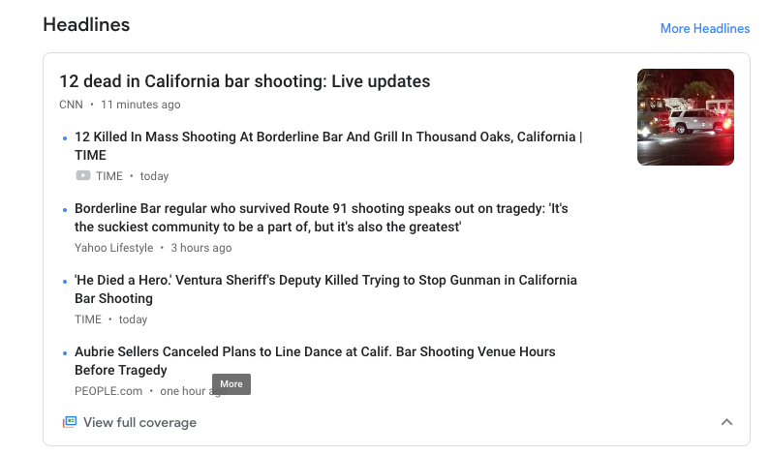
Multi-Document Summarization
Very useful for presenting and organizing search results
Many results are very similar, and grouping closely related documents helps cover more event facets
Summarizing similarities and differences between documents
Partial implementation: google news (does the grouping)

Slide 11
Scientific Article Summarization
Not just what the article is about but also how it relates to the work it cites
Show the relevant part of citation
Determine which approaches are criticized and which are supported
These are often more useful than the original abstract (abstracts don't have the context of how the work was received, won't be critical of the work)

Slide 12
Generic vs. Query-Focused Summarization
Generic
What is the overall content of this document (we will mostly focus on this)
Query-focused
Summary is with respect to an information need expressed in a user query
Can be thought of as a complex kind of question answering: answer the question by summarizing the document with the correct answer

Slide 13
Query-focused extractive example

Slide 14
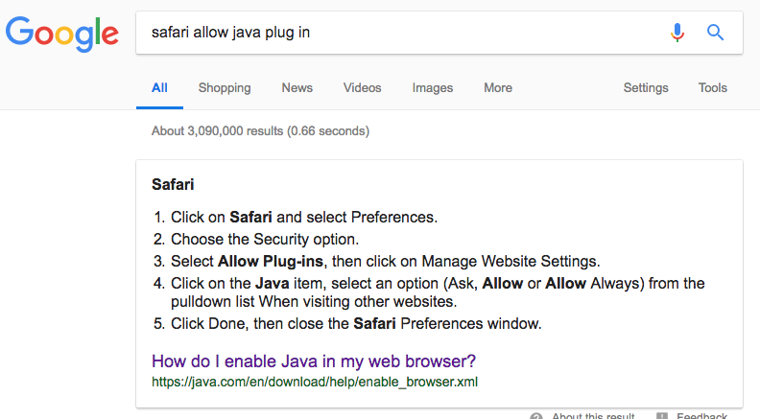
Query-focused extractive example

Slide 15
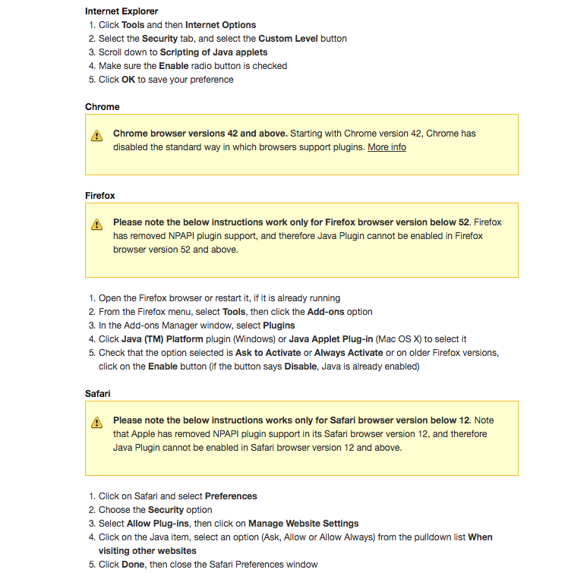
But...

Slide 16
Extractive Vs. Abstractive Summarization
Extractive: Create the summary from phrases or sentences in the source document(s)
Abstractive: express the idea in the source documents using (at least in part) different words
Most automatic summaries are extractive (it's easier!)
Most real-world summaries are abstractive (it's more natural!)

Slide 17
Input: LA Times Article
... (1400 words)
http://www.latimes.com/politics/la-me-pol-california-election-house-20181106-story.html

Slide 18
From input chunks to extractive summary
resoomer.com

Slide 19
Extractive Example
Resoomer.com/en

Slide 20
Abstractive Summarization
Nine police officers arrested an unarmed black teenager in California after he allegedly jaywalked and then scuffled with an officer. A video of the incident shows the officers surrounding the 16-year-old African American and forcing him to the ground after he got into an altercation with an officer who accused him of walking in a bus-only lane. The incident happened in the city of Stockton, 80 miles (130km) east of San Francisco, on Wednesday morning.
Video shows unarmed teenager forced to ground by group of Stockton police officers after allegedly walking in a bus lane
summari.es = repository of documents paired with summaries

Slide 21
Movie Script-to-Summary (Abstractive)
QUAID
I dreamed about Mars again... it
was bizarre, yet is was so real...
KIRSTEN
(casual)
It's your time of the month again.
Quail looks at her quizzically.
KIRSTEN
(continuing;
world-weary air)
At least once a month. Douglas
Quail's obsession. For twelve
years you've been talking about
Mars..
Construction worker Douglas Quaid is having troubling dreams about Mars and a mysterious woman there. His wife Lori dismisses the dreams and discourages him from thinking about Mars, where the governor, Vilos Cohaagen, is fighting a rebellion. At Rekall, a company that provides memory implants of vacations, Quaid opts for a memory trip to Mars as a secret agent. However, something goes wrong during the procedure, and Quaid starts revealing suppressed memories of actually being a secret agent. The Rekall employees sedate him, wipe his memory of the visit, and send him home. On the way, Quaid is attacked by his friend Harry and some other men, and is forced to kill them. He is then attacked in his apartment by Lori, who states that she isn't his wife; their marriage is a false memory implant, and Cohaagen sent her to monitor Quaid. He is then attacked and pursued by armed men led by Richter, Cohaagen's operative and Lori's real husband.
(... 19k words)

Slide 22
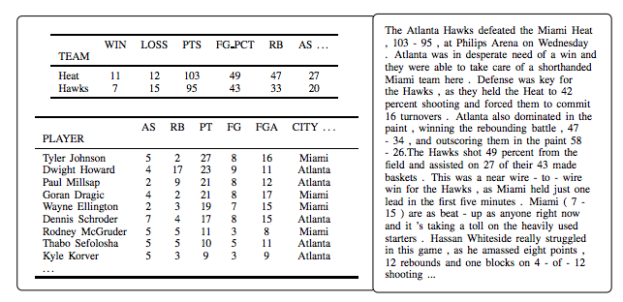
Structure to Sequence Summarization
(Wiseman et al. 2017)

Slide 23
We Have a New Problem. What Question to Ask First?
How do we evaluate?
MT issues: there's more than one way to translate pretty much anything!
But at least there are some
words in common! (Israel, airport)

Slide 25
Could we just use BLEU or METEOR?
Probably
But at the time of that last slide (2005), summarization research centered around a DARPA program (DUC) producing constrained-length summaries (50 words, 100 words, etc.)
We don't have to worry about variable-length output, so we can focus on recall of words in the reference instead of precision.
ROUGE
Recall-Oriented Understudy for Gisting Evaluation

Slide 26
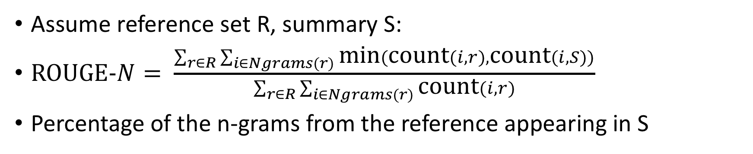
ROUGE-N (n-gram ROUGE)
Assume reference set R, summary S:
$\text{ROUGE}\text{-}N= \frac{\sum_{r∈R}{\sum_{i∈Ngrams(r)}{\text{min}(\text{count}(i,r), \text{count}(i,S))}}}{\sum_{r∈R}{\sum_{i∈Ngrams(r)}{\text{count}(i,r)}}}$
Percentage of the n-grams from the reference appearing in S

Slide 27
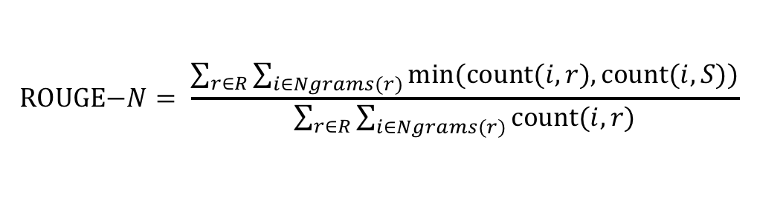
ROUGE-2 Example
$$\text{ROUGE}\text{−}N= \frac{\sum_{r∈R}{\sum_{i∈Ngrams(r)}{\text{min}(\text{count}(i,r), \text{count}(i,S))}}}{\sum_{r∈R}{\sum_{i∈Ngrams(r)}{\text{count}(i,r)}}}$$
Ref 1: Water spinach is a green leafy vegetable grown in the tropics.
Ref 2: Water spinach is a semi-aquatic tropical plant grown as a vegetable.
Ref 3: Water spinach is a commonly eaten leaf vegetable of Asia.
Hyp: Water spinach is a leaf vegetable commonly eaten in tropical areas of Asia.
3
+
3
+
6
= 12/29 = .43
10
+
10
+
9

Slide 28
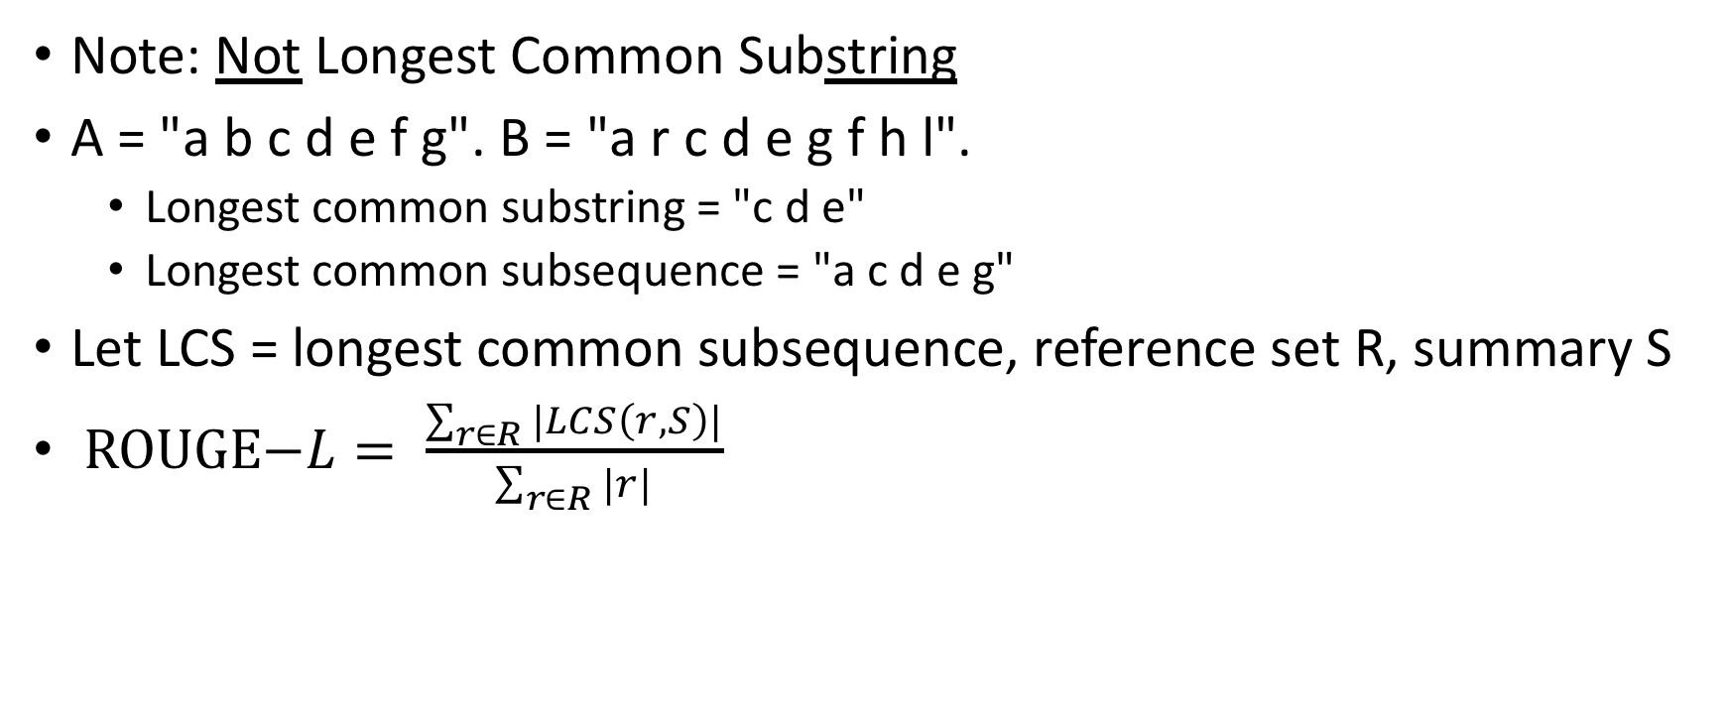
ROUGE-L Longest Common Subsequence
Note: Not Longest Common Substring
A = "a b c d e f g". B = "a r c d e g f h l".
Longest common substring = "c d e"
Longest common subsequence = "a c d e g"
Let LCS = longest common subsequence, reference set R, summary S
$\text{ROUGE}\text{−}L= \frac{\sum_{r∈R}{|LCS\left(r,S\right)|}}{\sum_{r∈R}{|r|}}$

Slide 29
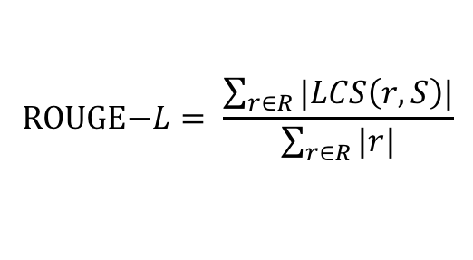
ROUGE-L Example
$$\text{ROUGE}\text{−}L= \frac{\sum_{r∈R}{|LCS\left(r,S\right)|}}{\sum_{r∈R}{|r|}}$$
Ref 1: Water spinach is a green leafy vegetable grown in the tropics.
Ref 2: Water spinach is a semi-aquatic tropical plant grown as a vegetable.
Ref 3: Water spinach is a commonly eaten leaf vegetable of Asia.
Hyp: Water spinach is a leaf vegetable commonly eaten in tropical areas of Asia.
"commonly eaten" or "leaf vegetable"
6
+
5
+
8
= 19/32 = .59
11
+
11
+
10

Slide 30
Okay, but do we still do fixed-length summarization?
Not exactly
In order to compare new work to prior work, standard sets are used, including DUC 2004, which was fixed-length
DUC was evaluated with ROUGE-1, ROUGE-2, and ROUGE-L, so most current work evaluates that way too, for continuity
Not necessarily the best, but the relative rankings don't really change much as you change metrics
The metric software is readily available which eases use (not that it's a hard metric to implement)

Slide 31
More Problems with ROUGE
Unlike with MT, humans don't really agree on even what sentences should be included in a summary
Disagreement of selection + Disagreement of word choice means that there is more opportunity for a good summary to be scored poorly

Slide 32
How To Do It

Slide 33
Basic Approach
Leave them in their original order
Don't bother cleaning

Slide 34
Selection: Which Sentences To Keep?
Sentence | Important?
Republican Rep. Steve Knight of Palmdale conceded defeat Wednesday in his bid for reelection and preliminary returns showed another GOP congressman, Dana Rohrabacher of Costa Mesa, losing his seat too. | Yes
Rep. Jeff Denham (R-Turlock) held a narrow early lead over his Democratic challenger, but also appeared in danger as late ballots are counted. | Yes
A fourth California Republican, Rep. Mimi Walters of Laguna Beach, held a wider advantage over her Democratic opponent, but that too could be challenging to sustain. | No
In California, late-arriving ballots tend to skew Democratic. | No
In another loss for the GOP in California, Democrat Mike Levin defeated Diane Harkey in the 49th Congressional District straddling the coastline of northern San Diego and southern Orange counties. | Yes
Levin will succeed retiring GOP Rep. Darrell Issa of Vista in the once-solid Republican district. | No

Slide 35
Unsupervised Approach
Intuition: Summary should contain sentences with words pertinent to the document, i.e. on topic
Words that appear frequently in a document are important to that document
But, words that appear frequently in other documents as well aren't important

Slide 37
Metric for topicality
tf*idf = term frequency * inverse document frequency
"Democrat" appears 30 times in this document, and in 40 other documents
"the" appears 45 times in this document, and in 10,000 other documents
"Mesa" appears 2 times in this document, and in 9 other documents.
Use tf*idf to weight each word in a sentence (can use other weight metrics). Average word weight is sentence weight. Keep highest scoring sentences.

Slide 38
Supervised Approach
Log-linear model classifying each sentence
Features:
Position in document (newspaper articles' 1st sentences are almost always useful, by design)
Cue phrases ("in summary", "in conclusion", "this paper", etc. Genre-dependent)
Word informativeness (e.g. tf*idf)
Sentence length (short sentences are usually bad)
Cohesive words (words/phrases that appeared in recent sentences)
Problem: It's hard to get purely extractive human summaries!
So a metric approach is often used

Slide 39
An Even Simpler Approach
Just use the first sentence (or so) of a document!
News articles are written in "inverted pyramid" style
Doesn't work for non-straight news articles
But very competitive ROUGE otherwise
This is often what the supervised/unsupervised approaches will learn anyway

Slide 40
Simplifying Sentences
Take out unimportant parts of the sentence, too.
Rule based approaches can work pretty well:
appositives | Rajam, 28, an artist living in Philadelphia, found the inspiration in the back of city magazines.
attribution clauses | Rebels agreed to talks with government officials, international observers said Tuesday.
PPs without named entities | The commercial fishing restrictions in Washington will not be lifted unless the salmon population increases to a sustainable number
Initial adverbials | “For example”, “On the other hand”, “As a matter of fact”, “At this point”
Supervised classifiers (e.g. simple neural networks) can also do this, provided enough training

Slide 46
Can't We Just Do This All With Deep Learning?
Of Course We Can!
(If we have training data)
Neural MT
Short English
English
Long English
French

Slide 47
Some problems with a direct application
The inputs and outputs are now much longer
Output is multi sentence
Input is very long
LSTMs and attention don't solve this problem on their own
This can lead to weird repeating behavior ("Germany beat Germany beat Germany...")
Separately, seq2seq will sometimes insert unmotivated text
Input: "Germany beat Argentina 3-2"
Output: "Germany won 2-0"
Particularly common for rare words
This is somehow more pronounced with summarization
(This section based on "Get to the Point: Summarization with Pointer-Generator Networks" by See et al.)

Slide 48
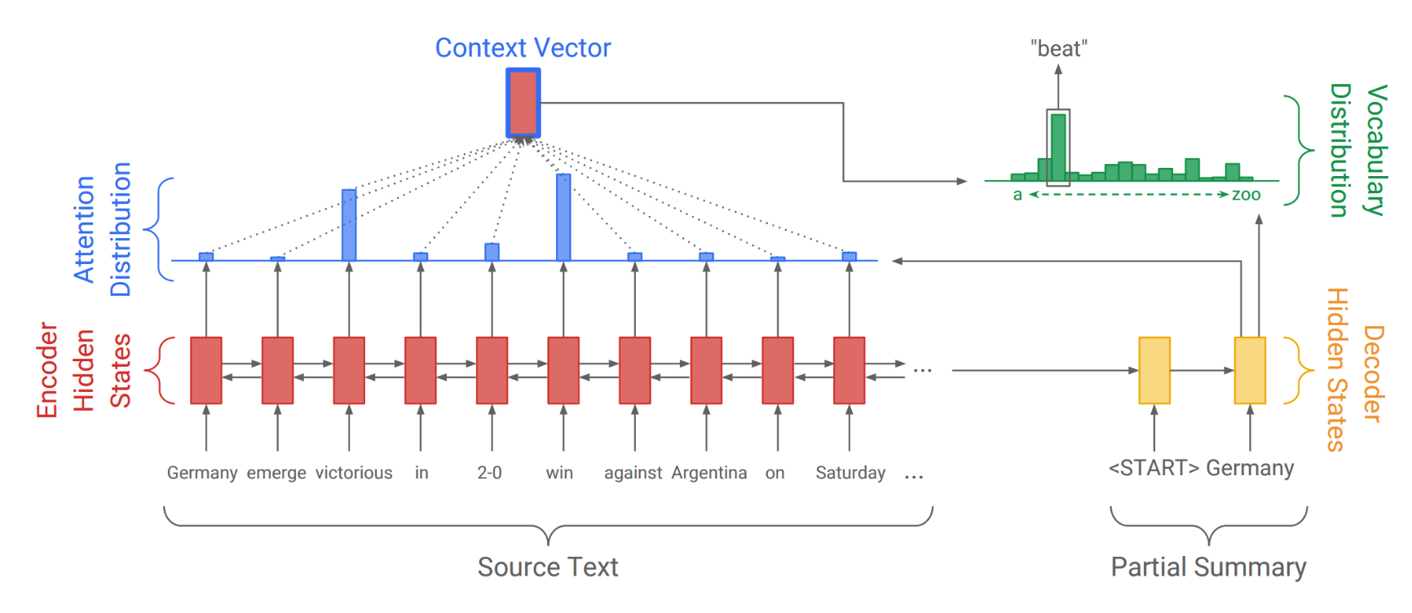
Seq2Seq for summarization (so far unchanged)

Slide 49
Looks Pretty Good For MT
But summarization does lots of copying. Even when we're being abstractive, we copy a bunch
Nine police officers arrested an unarmed black teenager in California after he allegedly jaywalked and then scuffled with an officer. A video of the incident shows the officers surrounding the 16-year-old African American and forcing him to the ground after he got into an altercation with an officer who accused him of walking in a bus-only lane. The incident happened in the city of Stockton, 80 miles (130km) east of San Francisco, on Wednesday morning.
Video shows unarmed teenager forced to ground by group of Stockton police officers after allegedly walking in a bus lane

Slide 50
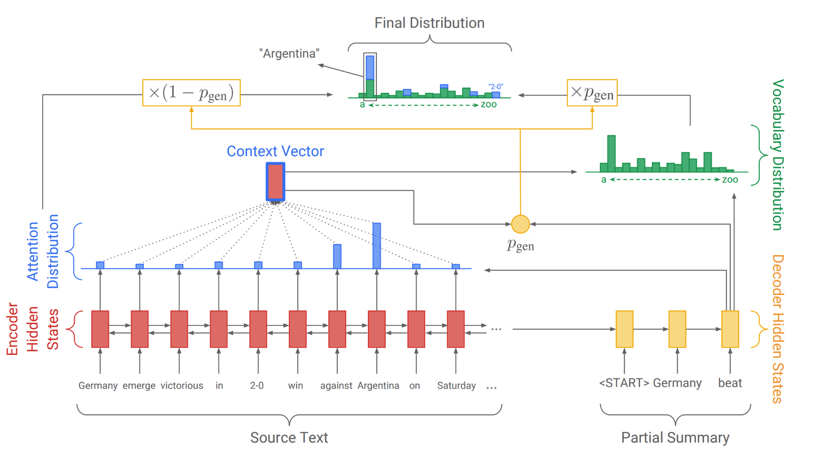
Same

Slide 51
Distribution over vocabulary

Slide 52
Original Distribution over vocabulary

Slide 53
How to combine those distributions

Slide 54
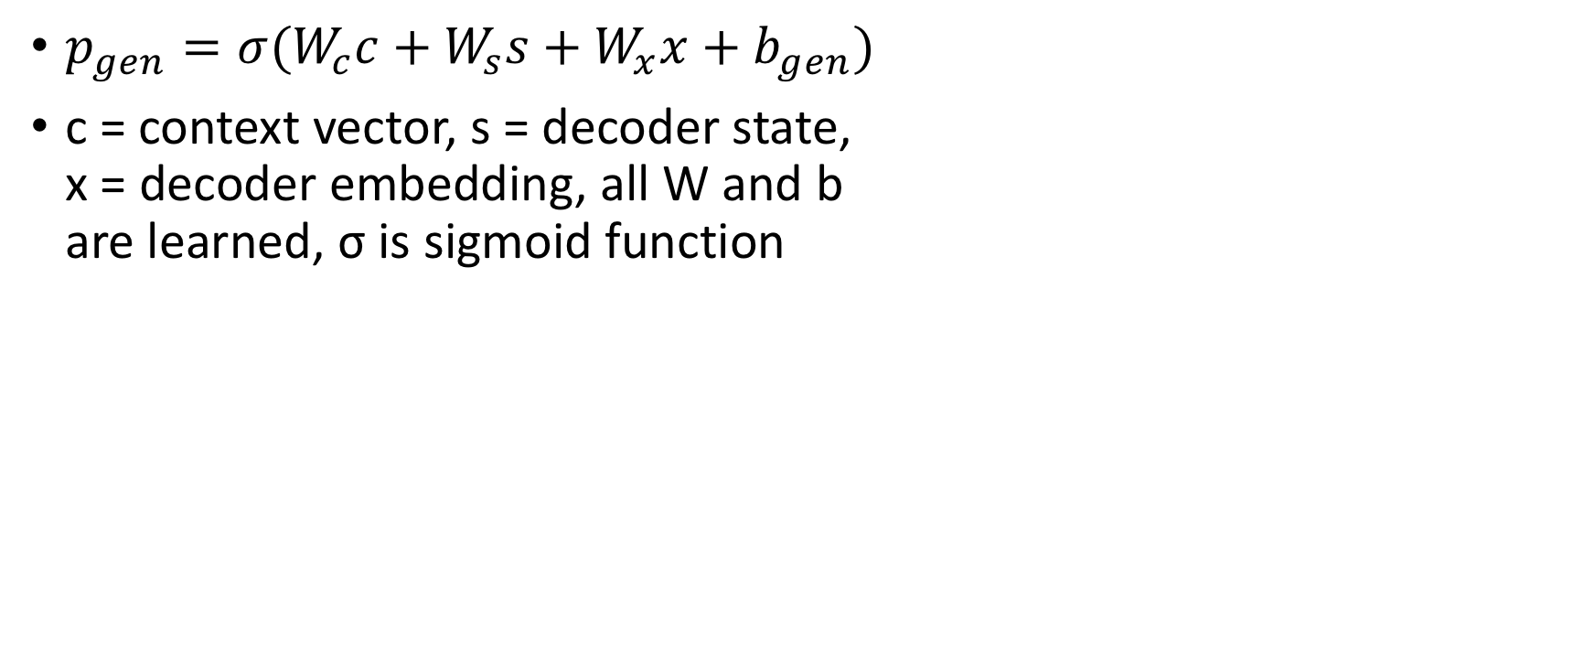
More Specifically
$p_{gen}=σ(W_{c}c+W_{s}s+W_{x}x+b_{gen})$
c = context vector, s = decoder state, x = decoder embedding, all W and b are learned, σ is sigmoid function

Slide 55
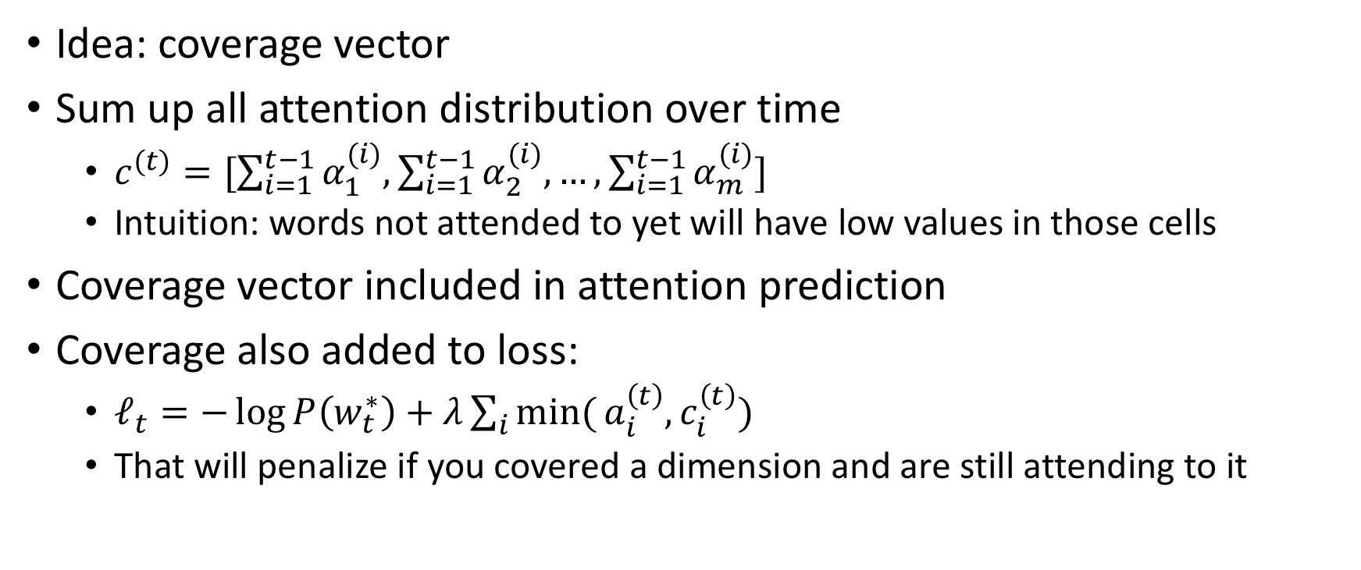
That covers copying, what about repetition?
Idea: coverage vector
Sum up all attention distribution over time
$c^{(t)}=[\sum_{i=1}^{t−1}{α_{1}^{(i)},}\sum_{i=1}^{t−1}{α_{2}^{(i)},…,\sum_{i=1}^{t−1}{α_{m}^{(i)}]}}$
Intuition: words not attended to yet will have low values in those cells
Coverage vector included in attention prediction
Coverage also added to loss:
$ℓ_{t}=−\log{P\left(w_{t}^{∗}\right)+λ\sum_{i}{\text{min}(}a_{i}^{\left(t\right)},c_{i}^{\left(t\right)})}$
That will penalize if you covered a dimension and are still attending to it

Slide 56
Example
munster have signed new zealand international francis saili on a two-year deal . utility back saili , who made his all blacks debut against argentina in 2013 , will move to the province later this year after the completion of his 2015 contractual commitments . the 24-year-old currently plays for auckland-based super rugby side the blues and was part of the new zealand under-20 side that won the junior world championship in italy in 2011 . saili 's signature is something of a coup for munster and head coach anthony foley believes he will be a great addition to their backline . francis saili has signed a two-year deal to join munster and will link up with them later this year . ' we are really pleased that francis has committed his future to the province , ' foley told munster 's official website . ' he is a talented centre with an impressive skill-set and he possesses the physical attributes to excel in the northern hemisphere . ' i believe he will be a great addition to our backline and we look forward to welcoming him to munster . ' saili has been capped twice by new zealand and was part of the under 20 side that won the junior championship in 2011 . saili , who joins all black team-mates dan carter , ma'a nonu , conrad smith and charles piutau in agreeing to ply his trade in the northern hemisphere , is looking forward to a fresh challenge . he said : ' i believe this is a fantastic opportunity for me and i am fortunate to move to a club held in such high regard , with values and traditions i can relate to from my time here in the blues . ' this experience will stand to me as a player and i believe i can continue to improve and grow within the munster set-up . ' as difficult as it is to leave the blues i look forward to the exciting challenge ahead . '

Slide 57
Reference summary
utility back francis saili will join up with munster later this year . the new zealand international has signed a two-year contract . saili made his debut for the all blacks against argentina in 2013 .
Baseline seq2seq
dutch international francis [UNK] has signed a two-year deal to join irish [UNK] super rugby side the blues . [UNK] 's signature is something of a coup for munster and his head coach anthony foley believes he will be a great addition to their respective prospects . [UNK] has been capped twice by new zealand .
+pointer generator
new zealand international francis saili will move to the province later this year . utility back saili made his all blacks debut against argentina in 2013 . utility back saili will move to the province later this year .
+pointer generator + coverage
francis saili has signed a two-year deal to join munster later this year . the 24-year-old was part of the new zealand under-20 side that won the junior world championship in italy in 2011 .
saili 's signature is something of a coup for munster and head coach anthony foley .

